Slide 1
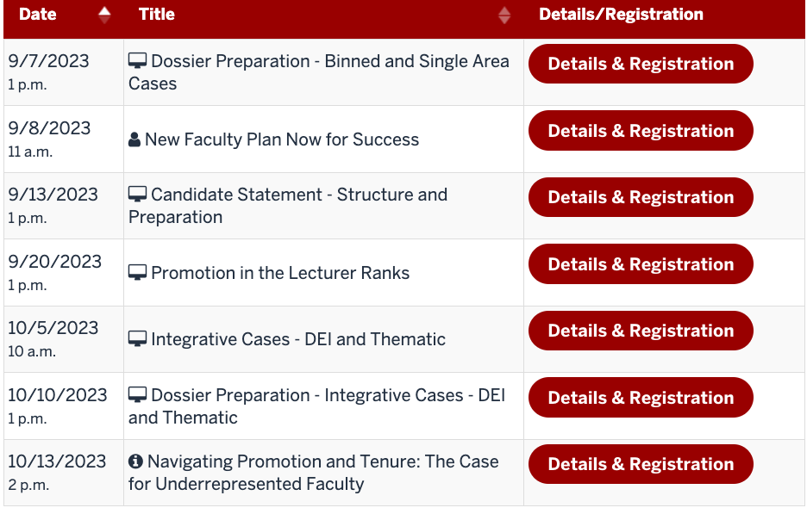
Upcoming P&T Workshops
https://academicaffairs.iupui.edu/Faculty-Affairs/promotiontenure/workshops/

Slide 2
Dossier Preparation:
Binned and Single Area Cases
Office of Academic Affairs
IUPUI

Slide 3
Welcome
Willie Miller
Faculty Advancement and Leadership Development Fellow
Margie Ferguson
Senior Associate Vice Chancellor for Academic Affairs

Slide 4


Agenda
World’s Best Dossier
You
Defining the dossier
Conceptually
What it looks like online
Dossier Components
Candidate Statement
IUPUI CV/DMAI
Regular sections
Appendices
The eDossier System
Preparing files
Using it
Critical Documentation Issues
Co-authorship
Teaching Evaluations
Documenting scholarly impact
Across the
finish line

Slide 5
This session vs. “Excellence in…” sessions
Other P&T Sessions
Excellence in….sessions
Teaching
Research
Service
Balanced Case
Integrative
Lecturer ranks
Clinical
Candidate Statement
P&T for Underrepresented Faculty
Promotion for Women
This Dossier Session
Dossier components
  Candidate statement (brief!)
  IUPUI CV
    DMAI
  Regular Sections
  Appendices
The eDossier System
  Preparing files
  Using it
Critical Documentation Issues
  Binning
  Co-authorship/Independence
  Teaching Evaluations
Finalizing the dossier and eDossier

Slide 6
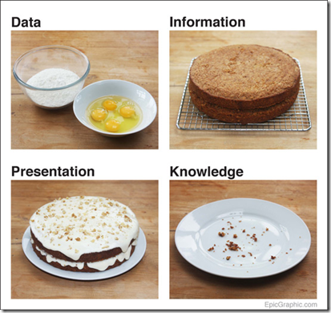
Defining the dossier
The dossier presents a clear case, with convincing evidence, for your promotion and / or tenure.
Your Dossier = Your CASE
List ←CV
Argument ←Candidate statement
Substantiation (documentation and details) ← main dossier
Raw materials ← appendices

Slide 7
Defining the dossier
The dossier presents a clear case, with convincing evidence, for your promotion and / or tenure.
What you’ve done
That you’re great!

Slide 8

The dossier, the eDossier
Your ”dossier” is the argument and evidence for your case.
Your “eDossier” is the format in which you submit it.
The system eDossier consists of MANY, MANY folders.
Don’t get lost! Don’t panic.
There’s flexibility built in.

Slide 9
Dossier Components

Slide 10
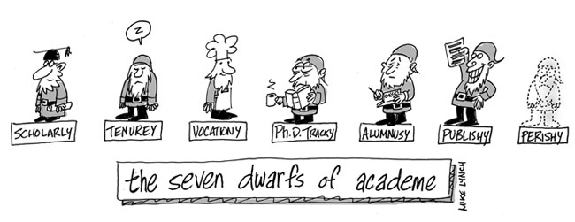
Candidate statement

Slide 11
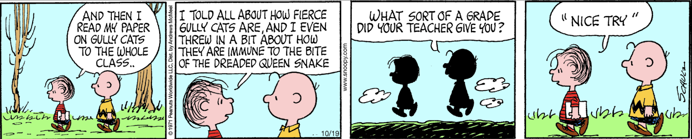

The candidate statement
P&T Resources Page

Slide 12
Candidate statement: states your case
For everybody:
5-7 pages (single-spaced; regular margins)
  Additional details or explanations go in the rest of the dossier
Your present accomplishments and your future plans
Levels of emphasis depend on:
Your rank: associate, full
Your area of excellence
Satisfying satisfactory in other areas

Slide 13
Template
Reference your department/school criteria
Focus, don’t dump
Edit for consistency with CV
Introduction: Who you are, what you are applying for, major points (1-3 paragraphs)
Section 1: Area of excellence: focus, subareas; signature work products Independence, grant trajectory if applicable, impact
Future plans
3-4 pages
Section 2-3: Addressing teaching, research, and service
At least satisfactory work in these areas—how you contribute to unit mission 1 page
Section 4: Summary
Distinctive individual contribution to unit/IUPUI/IU Plans for the future
1-3 paragraphs
DEI or Teaching case? A DEI philosophy or
Teaching philosophy can be separated or inter- woven.

Slide 14
A template, an example
Template
Example (entirely fake) Annotated example (still fake) Samples (real!)

Slide 15
IUPUI P&T CV

Slide 16
The IUPUI P&T CV
Is different from a disciplinary CV.
It contains additional information:
Course listings
Professional development attended
Unfunded grant submissions
It has a specific order of items.
All grants, presentations, and publications are binned.

Slide 17

The IUPUI P&T CV
For internal reviewers, places activities into total context
Is different from a disciplinary CV.
It contains additional information:
Course listings
Professional development attended
Unfunded grant submissions
It has a specific order of items.
All grants, presentations, and publications are binned.

Slide 18

The IUPUI P&T CV
Is different from a disciplinary CV.
It contains additional information:
Course listings
Professional development attended
Unfunded grant submissions
It has a specific order of items.
All grants, presentations, and publications are binned.
Campus committee has 125 - 200 cases to read

Slide 19
The IUPUI P&T CV
Is different from a disciplinary CV.
It contains additional information:
Course listings
Professional development attended
Unfunded grant submissions
It has a specific order of items.
All grants, presentations, and publications are binned.
IUPUI philosophy of distinct areas of excellence, satisfactory, satisfactory

Slide 20
DMAI (Watermark Faculty Insight)
Provides you with a complete template
If you have been diligent in populating it, DMAI will output the entire properly formatted CV.
Delete the cover page.
Delete the explanation right before Publications. Delete any irrelevant section.
Do not move things around.
Things are sorted into the right areas because you have labelled them as to area.

Slide 21
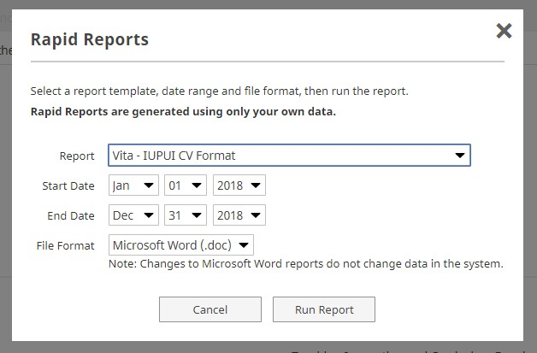
DMAI and P&T CVs
Rapid Reports function
  Vita
  Vita – IUPUI CV Format
Entries must have areas and
dates in order to be included
Edit the course listings to omit zero-enrollment sections
Don’t forget to
change the date!
Courses:
do not add student evaluation scores

Slide 22
Annotate the CV? Markers?
Some faculty place small annotations within the CV.
DO NOT neglect these issues in the rest of the dossier: the CV does not substitute for other areas.
Examples:
Publications: citations to that article
Presentations: acceptance rate
Multi-author works: brief mentions of your role
Markers:
Student co-authors: generally indicated by a dagger
Your authorship: often indicated by bolding
In-rank: EITHER:
  Use an asterix *
  Grey out not-in-rank items: especially useful for cases for full.
DEI items: #

Slide 23
New! CV Formatter
Requires 3 things:
The Courses report from DMAI
Listing of grants from DMAI or GMT
Regular, up-to-date disciplinary CV

Slide 24
If you don’t want to use DMAI
We have ‘tabbed’ and ‘table’ formatted Word documents: Dossier Forms.
You will have to input lists of courses in the approved format: consider going to DMAI for that and pasting them in. DMAI is auto-loaded with all your courses since you came here or 2012, whichever is later.
The IUPUI P&T CV is instantly recognizable.
Campus reviewers will know if you are not following this outline.

Slide 25
Regular Sections & Appendices

Slide 26
Recap: 3 parts to your case
CV = list
Candidate statement = a coherent and compelling argument, covering your MAIN area of excellence, that you are ALSO satisfactory in other required areas, and presenting a plan for the future.
Dossier main sections =
Additional details (how competitive is that award?)
Contextual information (e.g. load details)
  These are especially important for readers NOT in your unit
Confirmatory evidence (co-author statements, grant abstracts)
50-Page Limit
  Appendices: are not used at the campus level. What does your unit expect?

Slide 27
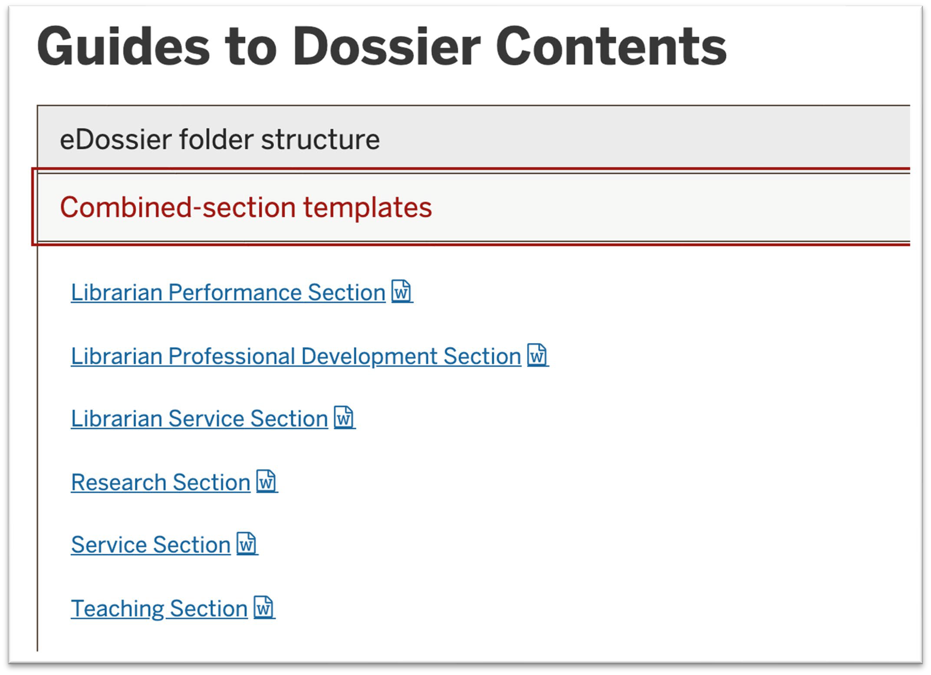
Dossier folders
Use these Word templates to gather all your information into
ONE pdf.

Slide 28
Typical appendix materials
Course syllabi, assignments
Copies of key articles (or, link via CV.)
Complete student evaluation reports,
peer evaluations
Letters of appreciation from students or community
You can REFER to these documents in the main section or your candidate statement. You can create internal links within eDossier, however, no external reviewer will be able to use them.

Slide 29
The eDossier System

Slide 30
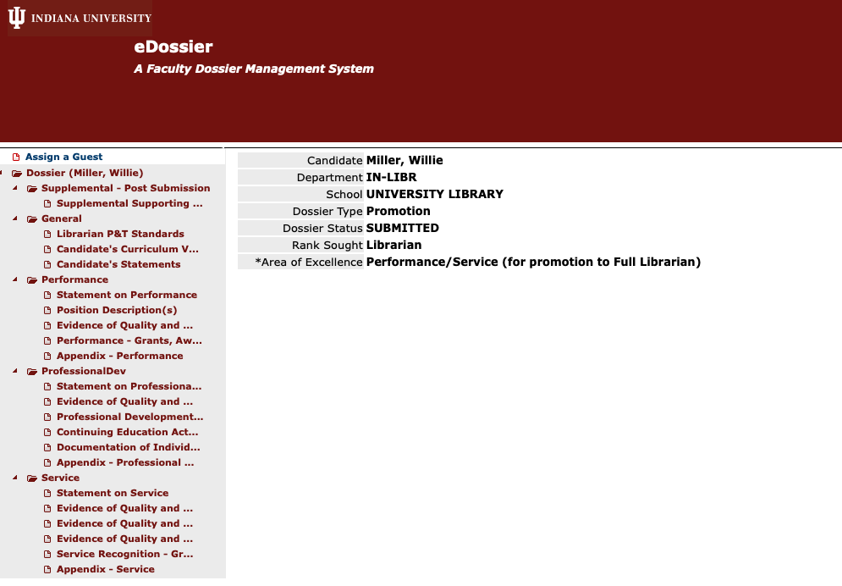
What e-dossier looks like to candidates

Slide 31
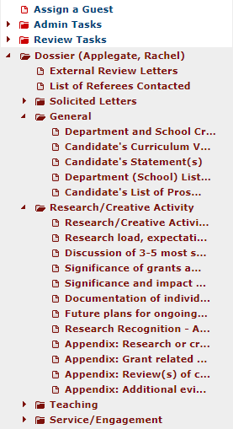
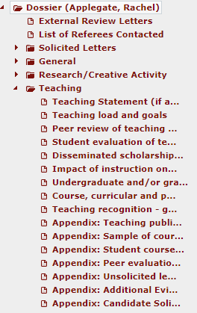
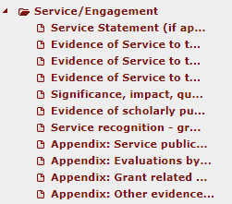


These appear in one long vertical list on the left side;
Open and close the various areas using the triangle

Slide 32
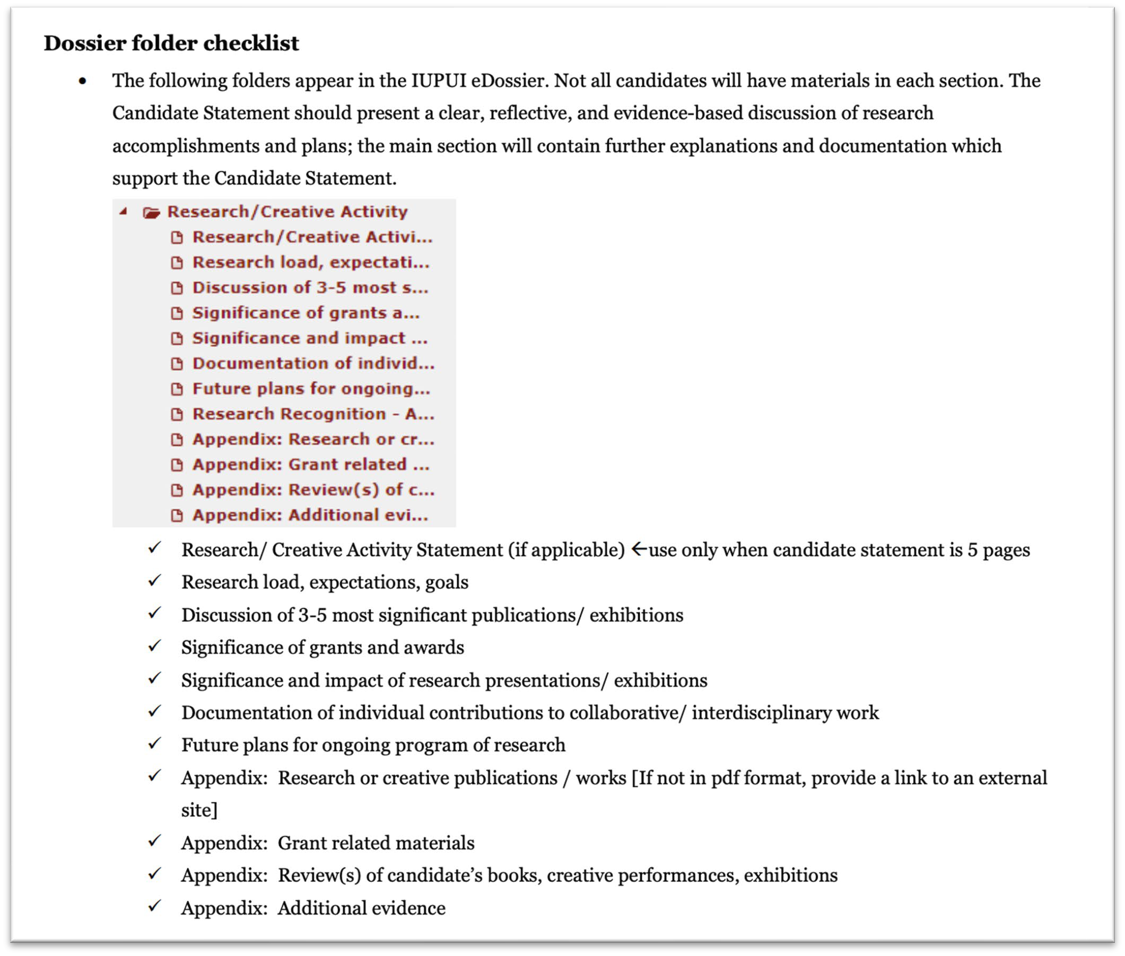
The P&T Guidelines list all the sections

Slide 33
Finalizing the dossier
Summer before review year
IUSM: earlier
eDossier NOT available until late summer
Decision:
Save everything into appropriate folders OR
You may save everything in EACH main section in ONE file
Use WORD format for eDossier files. (This is a new recommendation.)
Maximum of 50 pages (including candidate statement, 5 OR 7 pages; NOT including CV) for the regular folders
  This is a conceptual limit. Don’t make readers think you are ignoring the limit; don’t fret over half-pages.
ALERT! E-DOSSIER FREEZES ONCE YOU SUBMIT AND THE CHAIR CONCURS! NO CHANGES CAN BE MADE, ONLY ADDITIONS IN A SPECIAL FOLDER.

Slide 34

Why eDossier?
Secure storage
Per IU policy, decisions are made ONLY on materials IN the e-dossier.
Routing
Each level is separate and can only work once the previous level has finished = be prompt!
Primary (dept) committee
Committee votes and reports
Chair votes and reports
Unit (school) committee
Committee votes and reports
Dean vote and report
Candidates are notified at each stage by the responsible party.
Adjustments made for schools without departments, or core schools.

Slide 35
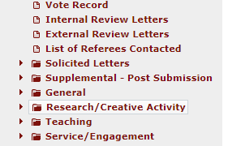
After submission
New material
Supplemental folder
Storage
Routing
Notifications

Slide 36
What does ‘new material’ mean?
General updates:
  Changes of status to items (e.g. publications accepted, grants received)
  Corrections: after a dossier is submitted, NO changes can be made; new or changed versions need to be uploaded to the Supplemental folder
  Consider how important these are. Use sparingly; label clearly
  Generally avoid narrative: present new evidence

Slide 37
If I have something amazing happen in my review year?
It was too late to get into my dossier.
SAVE IT for your promotion-to-full case!
Your promotion-to-full case is based on ‘work in rank’ i.e. work completed since your last promotion.
Anything that was not ready to go into THIS promotion is available for your NEXT promotion.
In other words, do NOT update your dossier with additional materials unless only with that new material would you be successful.

Slide 38
Critical documentation issues

Slide 39

Binning

Slide 40
Grants/publications/work/dissemination and the Area of Excellence
Make your area of excellence as strong as possible
For tenure-track faculty
If Research is the area of excellence, dissemination is NOT required in teaching or service.
If Teaching or Service are the area of excellence dissemination is required in BOTH Teaching-or-Service AND research.
Balanced-binned case? Dissemination required in Teaching and Research.

Slide 41
Grants/publications/work/dissemination and the Area of Excellence
Make your area of excellence as strong as possible
Non-tenure track: For the purpose of IUPUI promotion:
Clinical faculty: publications, presentations and grants must be either service or teaching
Lecturer-rank faculty: publications, presentations, and grants must be in support of teaching.
Research faculty: publications, presentations and grants can only be labelled as research.

Slide 42
For tenure-track faculty:
Type of case | Dissemination Requirement
Excellence in | Teaching | Research | Service
Teaching | X | X | --
Research | -- | X | --
Service | -- | X | X
Balanced case- binned | X | X | --
Balanced- Integrative | peer-reviewed scholarship required, need not be binned
Notes:
For the balance case-binned, a candidate may not have dissemination that has gone through a peer-review process.

Slide 43
Co-authorship (independence)
There’s no ‘we’ in promotion. Or tenure.

Slide 44
Provide confirmatory information
Author order: your chair will explain the conventions for author order and role.
  If you are not first author but ARE ‘corresponding’ author, indicate that.
  Many readers will default to believing the first author and the last author are the only ones who are important. Explain!
Include statements from co-authors about your contribution.
  Send simple emails: you did this, I did that, right? Preserve the response.
  Save any journal forms which capture responsibility.
This is especially important when you often collaborate with the same people /and/or/ those same people are your dissertation chair or senior members of your department.

Slide 45
More on collaborator confirmation
All tenure cases require scholarly independence: a unique and confirmed role in the production of scholarship.
‘Unique’ means, the scholarly product would not be the way it is without YOU participating (‘hire a consultant’ vs. ‘work with YOU.’)
‘Confirmed:’ Some or all of these:
Lead author responsibility.
Differing co-authors; not always your dissertation chair or senior members of your department.
Clear articulation in the candidate statement of what YOU contributed.
Emails from at least one collaborator for at least your “3-5 most significant” works of scholarship. “I did this, you did that, right?”

Slide 46
Teaching evaluations
All faculty with teaching responsibilities (=all except research scientists) must have:
Student (learner) evaluations Peer evaluations
If you are not yet full rank, don’t forget to keep going on evaluations.
School of Medicine
They will supply faculty with reports of student evals They will connect you with someone for a peer evaluation
Place in ‘Teaching’ part of dossier; use about ½ page to discuss your teaching progress and goals.

Slide 47
Peer evaluations
“Peer” means “fellow faculty member.”
They do not need to be of a higher rank or of your same type; experienced senior lecturers or teaching professors would be very good.
CTL staff are also okay but only in addition to fellow faculty.
For excellence-in-teaching cases: one per type of teaching per year. For satisfactory-in-teaching: at least two. Best: one per year.

Slide 48

Hi, I’m a professor
But you don’t look like one.
(Image from google: ‘professor image’)

Slide 49
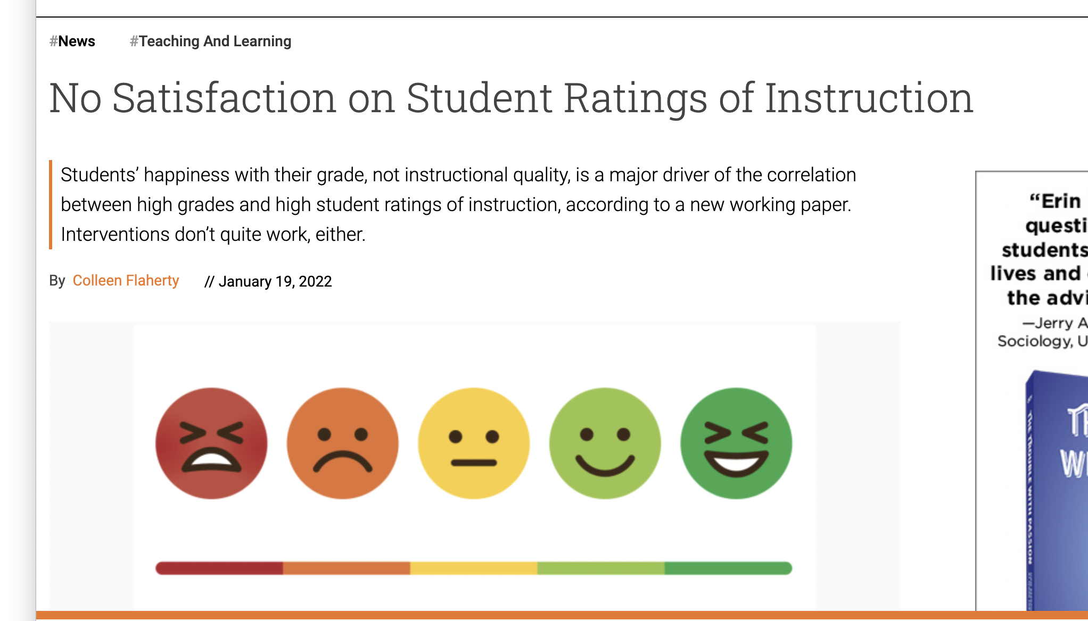
Student evaluations
1/19/2022 article
Extensive research shows some faculty get higher scores than they deserve and others lower, when they don’t conform to student expectations.
NEITHER a high NOR a low score is sufficient evidence of teaching ability or impact.

Slide 50
Student evaluations
Teaching gateway courses, hard courses, specialized courses, unusual topics, new methods….
the main point is:
how do YOU monitor student success and continually improve as a teacher?
Gives students an anonymous way to make comments without fear of retaliation.
  Student evaluations are the ONLY anonymous material allowed in faculty records.
Individual items (questions), and individual comments, can be used by faculty to improve their teaching.
For promotion and tenure the most important point is to discuss how YOU use input from:
  Student evaluations
  Peer evaluations
  Student work/accomplishments
  To improve your teaching.

Slide 51
Finalizing the dossier and eDossier

Slide 52
Effectively presented
Sample Dossiers
must be logged into IU Login
Fulfills all of the technical requirements
  This shows readers that you respect the process and their time and effort
Avoids editing or typographical errors
  Errors cause your readers to slow down, to stumble and eventually to get irritated
Presents sufficient information but not too much
  Massive, undifferentiated information causes your readers to miss your main points

Slide 53
Please Don’t
Typos (“Presentatons” “Publicatoin”)
Writing in the third person (“Dr Tchaikovsky has many publications”)
Personal information (Children: Dylan (12) and Abel (10)).

Slide 54
Important for Campus Committee
Web
CV is in IUPUI format (either binned or integrative)
  publications are ‘binned’ except for integrative cases; even in research-only cases, the heading should be “Research.”
  nothing is labeled as ‘research’ for lecturer or clinical faculty
  tenure track faculty whose area of excellence is service OR teaching must have at least SOME publications in ‘research’
  for promotion to full, there are clear markings for ‘in-rank’ publications/grants
Statement is no longer than 7 pages
Statement states within the first paragraph what the area of excellence is and the specific candidacy
Body of dossier contains evidence of student teaching evaluations and at least 2 peer evaluations of teaching (regular dossier or appendix) (all but research scientists.)

Slide 55
Important for Campus Committee
Web
Also, ideally
Key publications on CV have DOIs or links
There is consistency between #s of publications and $$$ of grants in the CV and summarized in the statement
All acronyms except NSF and NIH are explained at least once
If the person is a co-author or co-PI, there is at least some indication of collaborator confirmation of individual role in grants or publications.

Slide 56



What reviewers are thinking….
Wow, you’re amazing
This is easy!
Okay, managed to cover the basics
I found what I needed
Seriously?
But no, we’re not going to fail you for that
Or maybe we are

Slide 57
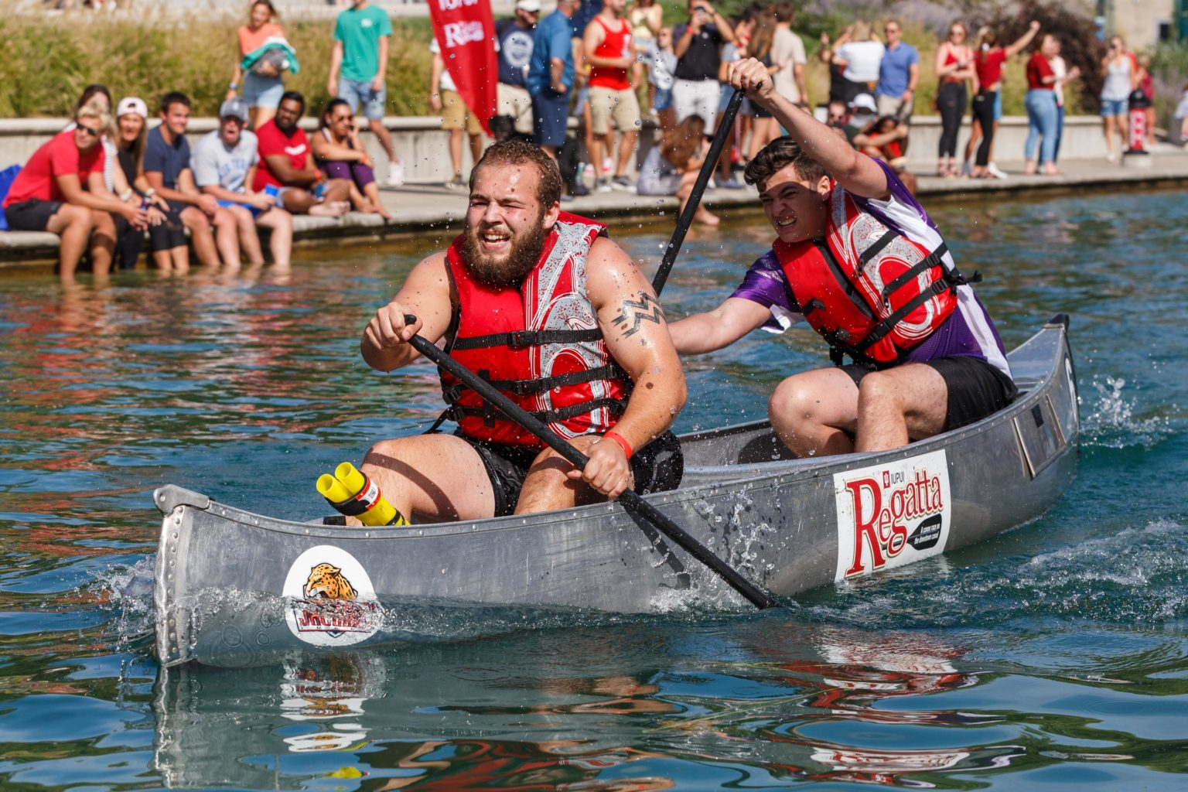
Get across the finish line!

Slide 58
Q&A

Slide 59
Side trip:
Help your chair with:
Identifing external reviewers Assessing dissemination outlets
Very school-specific

Slide 60

Materials for external reviewers
Spring before review year
IUSM: earlier
CV: either IUPUI or disciplinary format: ask your school Candidate statement
Materials to support their evaluation
Chair will handle:
Conflict of interest statement
Documenting receipt of information
Don’t contact anybody about the review!

Slide 61
Assessing dissemination outlets
Responsibility of the chair
Candidates:
Keep chair informed year by year of why you are publishing/ disseminating where
Explain when you are using a new or unusually focused venue (why is it appropriate for your particular work?)
If your discipline or unit has an accepted ‘high value’ list of venues, be sure you know about it!

Slide 62
Special FAQ: time in rank

Slide 63
Does “x” work count as “in-rank”?
This is very very generic information. Cases vary and so do attitudes. Try to get agreement on your definition before your dossier is submitted.
For those going for promotion-to-associate and tenure, generally everything they have done will be considered “in rank” because you have not yet been promoted.
Tenure is specifically about trajectory, your past and future, and reputation, and reputation rests on everything you have done.
“In rank” is about rank, not faculty-type.
If you are applying to the highest rank (full clinical, full tenure track, full research, full librarian, and teaching professor):
You need a strong record of distinct accomplishments achieved after your associate-level promotion.
Your external reputation will inevitably be based on everything you have done

Slide 64
How long do I have to be in-rank?
There is no rule.
There is a mental guideline that most people have had 5 or so years of experience and accomplishments in their current position/rank before applying for the next.
External reviewers will not care much about ‘in rank’ but will care about your current national impact/reputation, built on everything you done.
Internal reviewers will assess whether your level of performance is sustained. Sustained means something more than a “one hit wonder” [unless it’s the Nobel Prize.].
For full, periods of time that were less productive are understood and even expected.
“There is no defined period between associate and full rank, although most candidates seek full rank five to ten years after promotion to the associate rank. Occasionally, the period under consideration may vary due to: Prior appointments at other institutions; the cumulative nature of some work that may build on earlier accomplishments; leaves that may have extended the probationary period; administrative roles; or earlier than normal consideration.”

Slide 65
Willie Miller
Faculty Advancement and Leadership Development Fellow
wmmiller@iupui.edu
Margie Ferguson
Senior Associate Vice Chancellor for Academic Affairs
mferguso@iupui.edu
Rachel Applegate
Assistant Vice Chancellor for Faculty Affairs
rapplega@iupui.edu

Slide 66
Contacts for School of Medicine
Megan Palmer, Senior Associate Dean for Faculty Affairs and Professional Development, mmpalmer@iu.edu
Neelam Chand, Executive Director for Faculty Affairs, nchand@iu.edu
Krista Longtin, Assistant Dean for Faculty Affairs and Professional Development, klongtin@iu.edu
https://medicine.iu.edu/faculty

